Slide 1
BRITISH AIRWAYS CUSTOMER REVIEW
BY IYOBOSA IBUDE

Slide 2
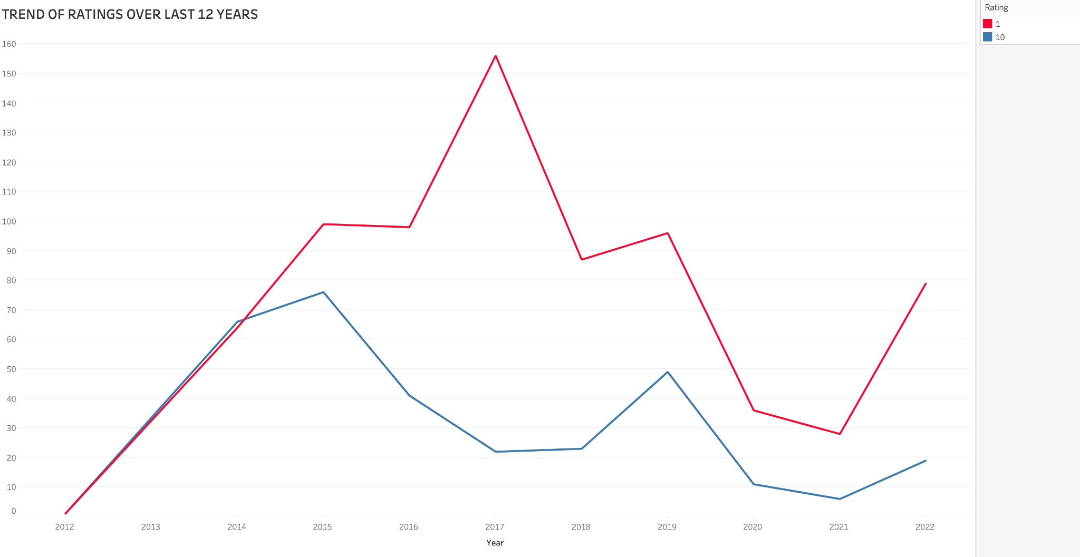
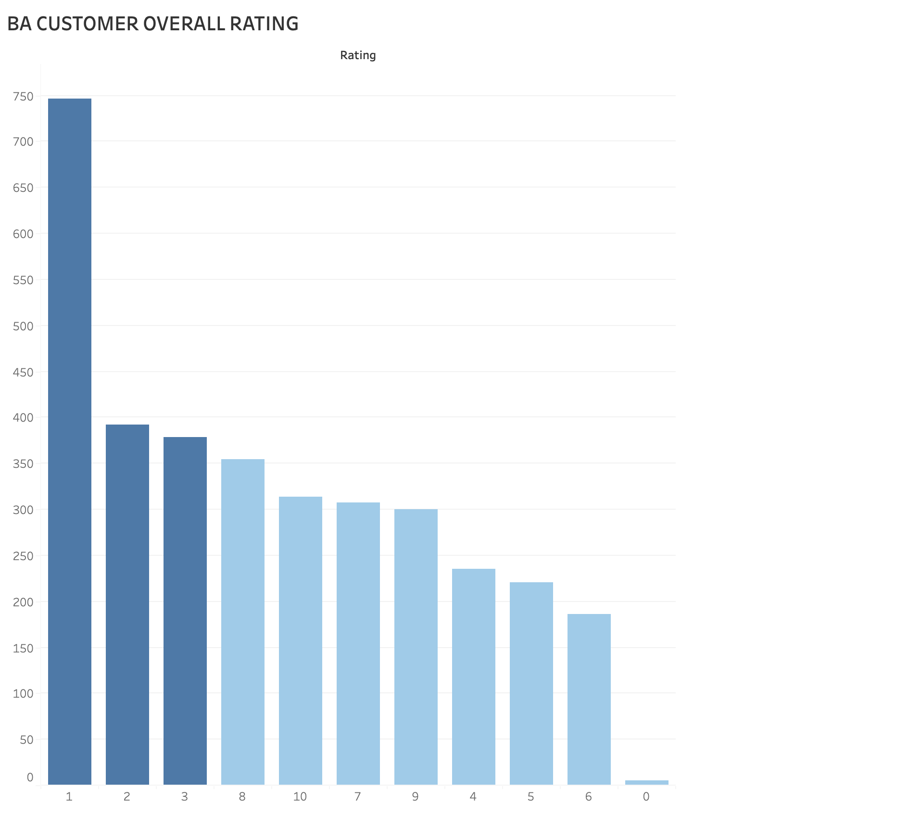
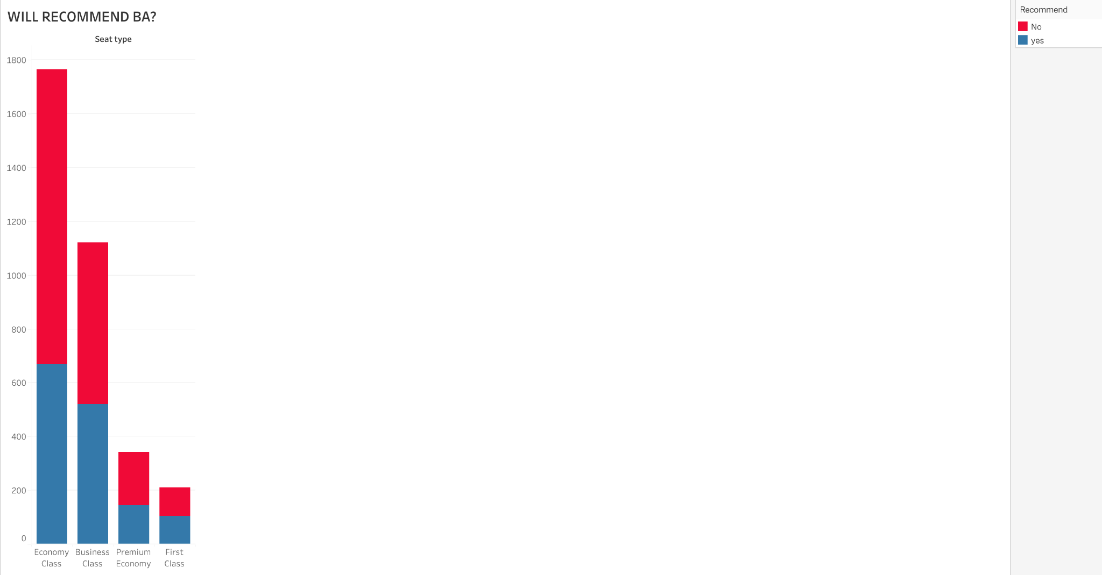
Most customers have found BA services to be on the decline since 2015
Most customers give BA a low overall rating
Most customers who fly economy and business class do not recommend BA

